Slide 1
Roles and Position
What is a role?
Could structural similarity indicate similar roles?
Must go beyond local structure, i.e. degree, CC
Structural similarity == structural equivalence
2 vertices are structurally equivalent if they have the exact same ties (or arcs) to the exact same others

Slide 2
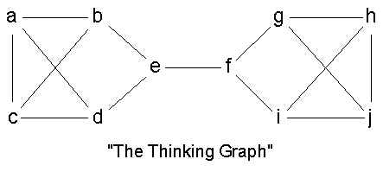
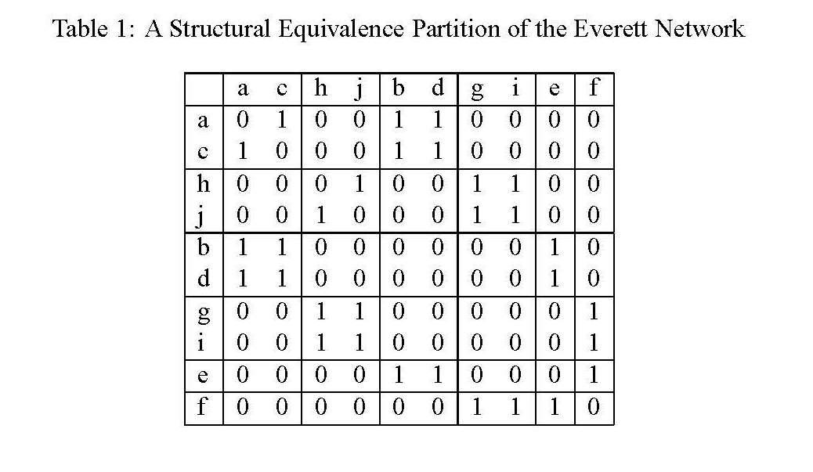
Note the blocks!!

Slide 3
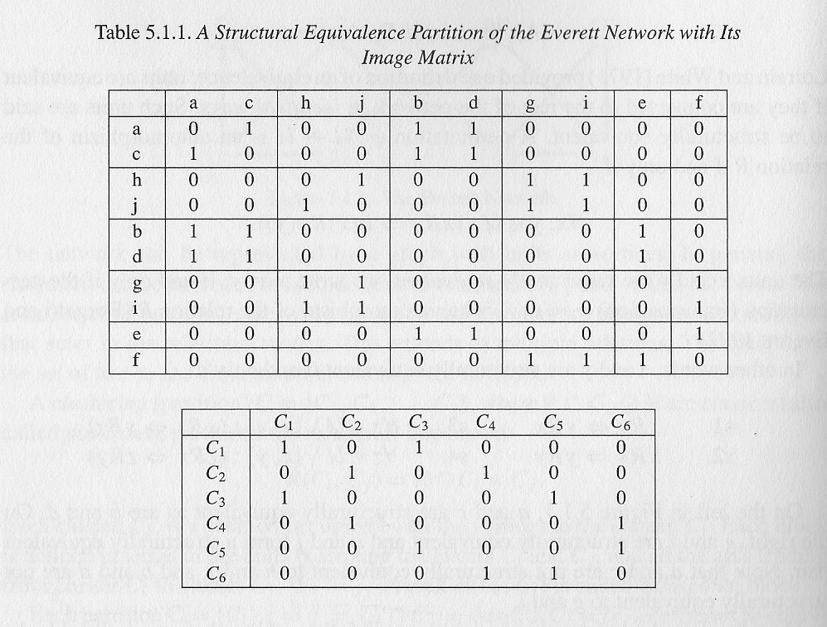
Reduced adjacency matrix → Image matrix (reduced matrix)
But things are never this simple

Slide 4
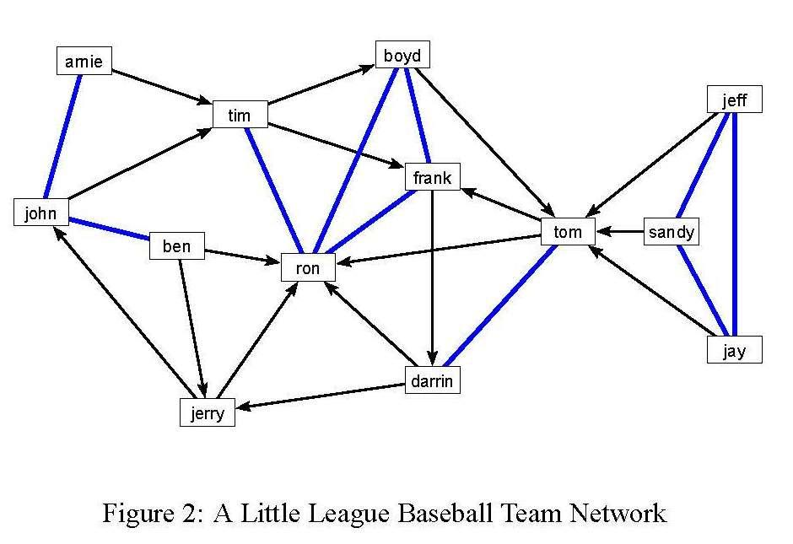

Slide 5
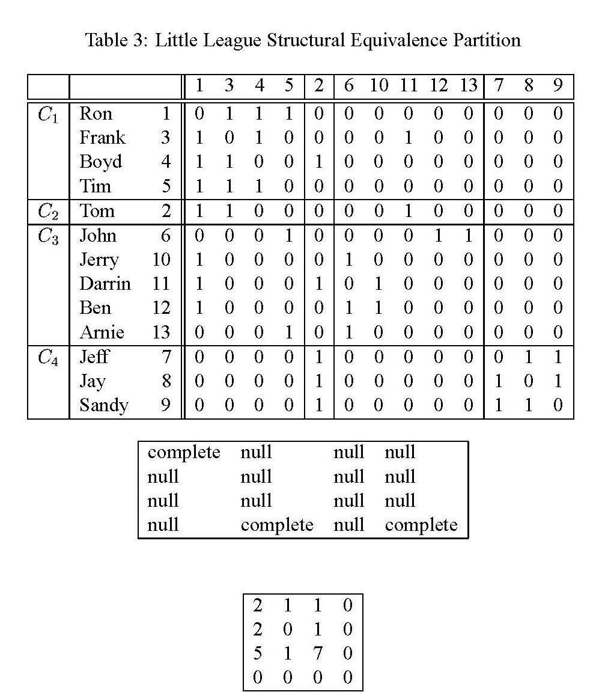

Slide 6

Finding Blocks
If two actors are structurally equivalent → in the same block
But if no two actors are exactly structurally equivalent, we can compute measures of structural similarity -- stochastic methods
Euclidean distance
Pearson product moment correlations between two row vectors of the adjacency matrix

Slide 7

Blockmodeling
In Burt's (1976) Euclidean distance approach, the basic idea is to:
  Generate the distance matrix D
  And the use a scaling method (e.g. MDS, PCA, hierarchical clustering) to come up with a reduced form representation of the various groups

Slide 8
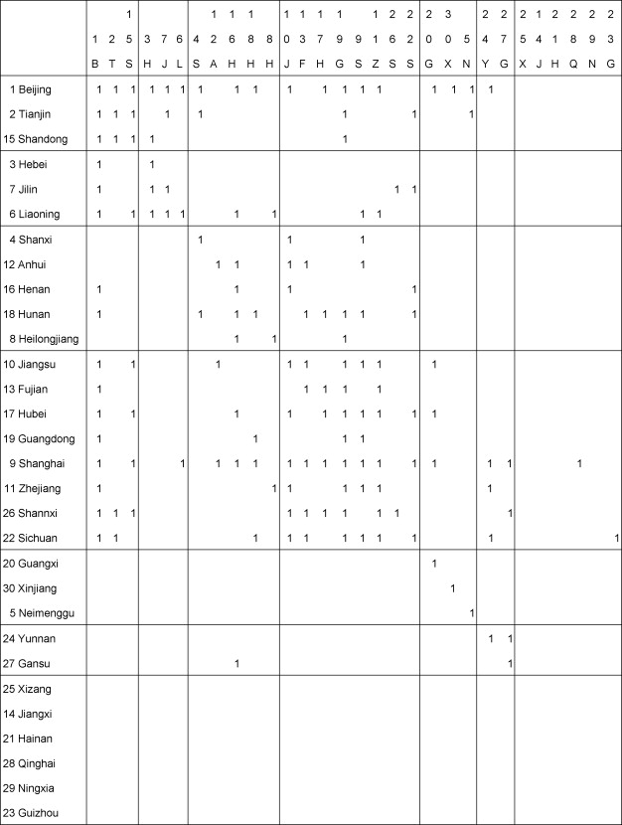
Blockmodeling
In Breiger, Boorman and Arabie's CONCOR strategy, the basic idea is to:
  Generate the (initial) correlation matrix C₁ from A
  Iteratively obtain further correlation matrices {C_{2,} C₃, ...}
  until we have a "final" correlation matrix C_{k} that contains only +1 and -1 entries

Slide 9
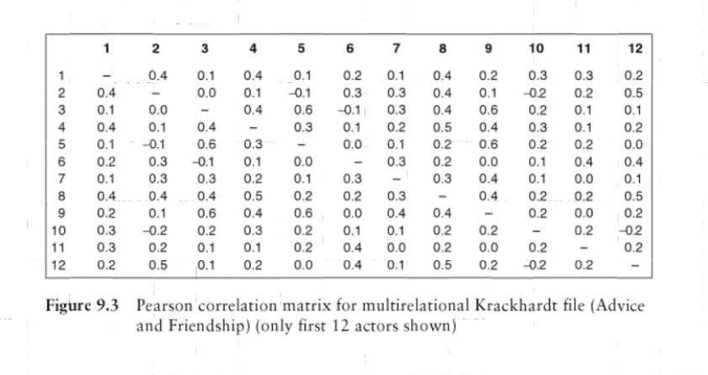

Slide 10
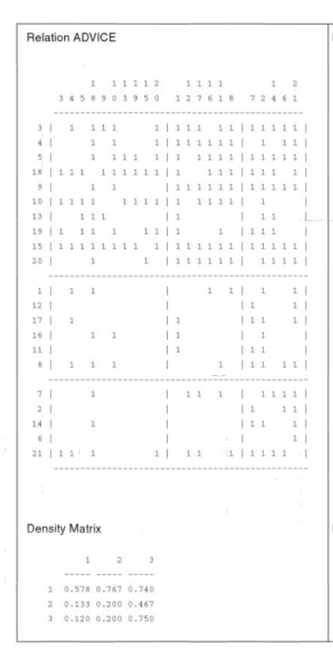
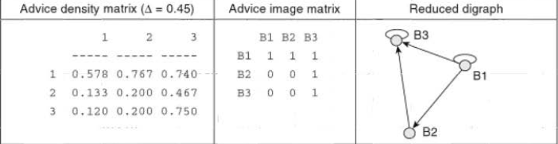

Slide 11
Regular Equivalence
Is structural equivalence a measure of role similarity?
Structurally equivalent vertices have the same connection pattern to the same neighbors
Regular equivalence: same connection to similar (regularly equivalent) others
Regular equivalence

Slide 12
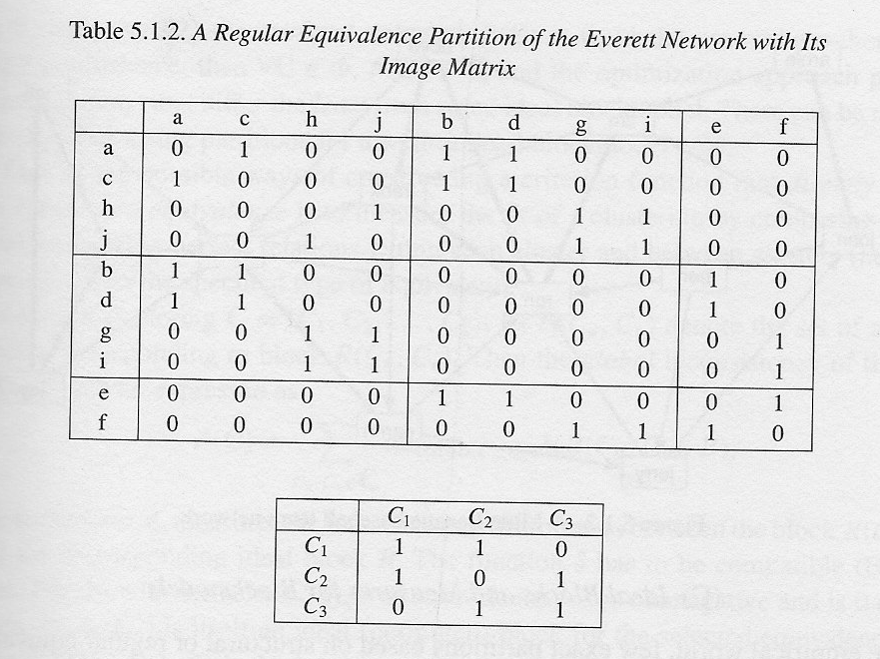

Slide 13
Regular or Structural Equivalence?
Equivalence?
Structural: too strong, not the exact same others
Regular: intuitively clear, computationally complex
How to classify vertices into classes so that within a class vertices are similar in terms of their connections to other vertices?
Incorporate non-local information
But why?

Slide 14
Structure and Function
Structurally similar vertices perform the same function (have the same role)
Position in a sub-graph
  in the whole graph (structural equivalence)
  in some part of the graph
  But what part of the graph?
Motifs and graphlets
Triads

